Slide 1
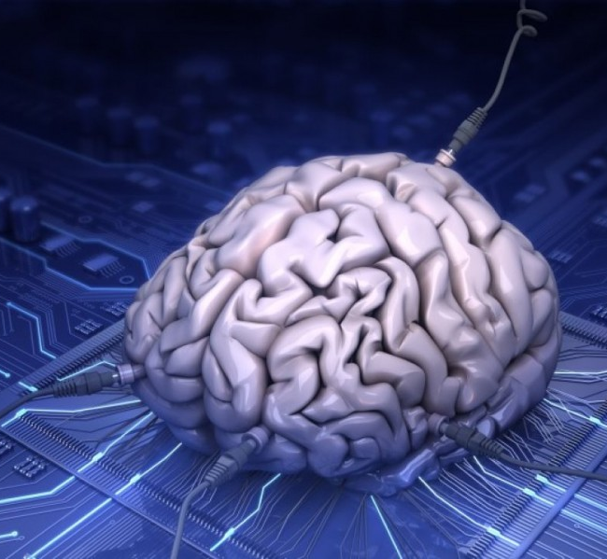
Bio computer
By: Mohamed Hussein
Mohamed A Salama
Mostafa Oraby
Mostafa Farghaly
Mostafa M Salaheldeen
Mahmood Hany
Mazen

Slide 2


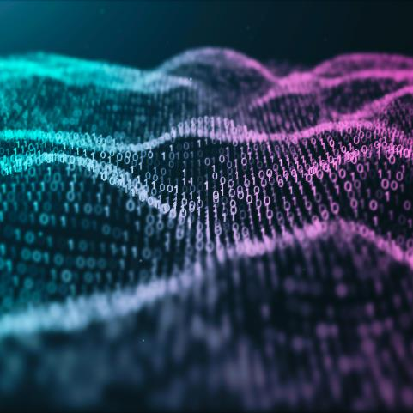
What is bio computer
a (hypothetical) computer based on circuits and components formed from biological molecules or structures.

Slide 3
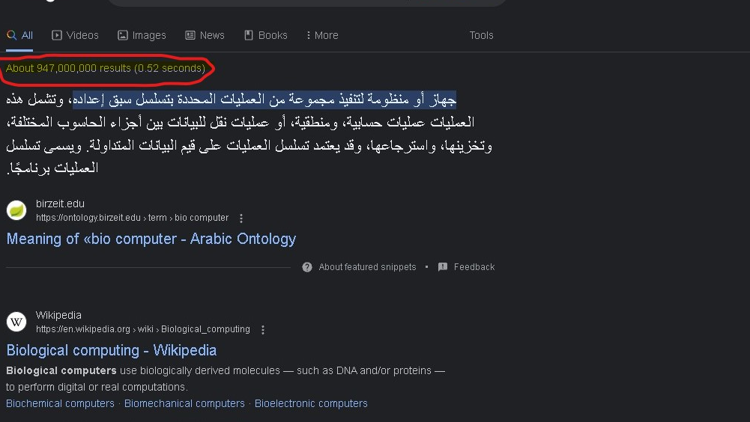

Slide 4


Information traffic : 1 zettabyte per year
Or billion tera byte per year
And going to reach 200 zettabyte in 2025

Slide 5
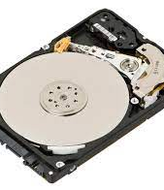
Hard drive can not hold

Slide 6


Slide 7
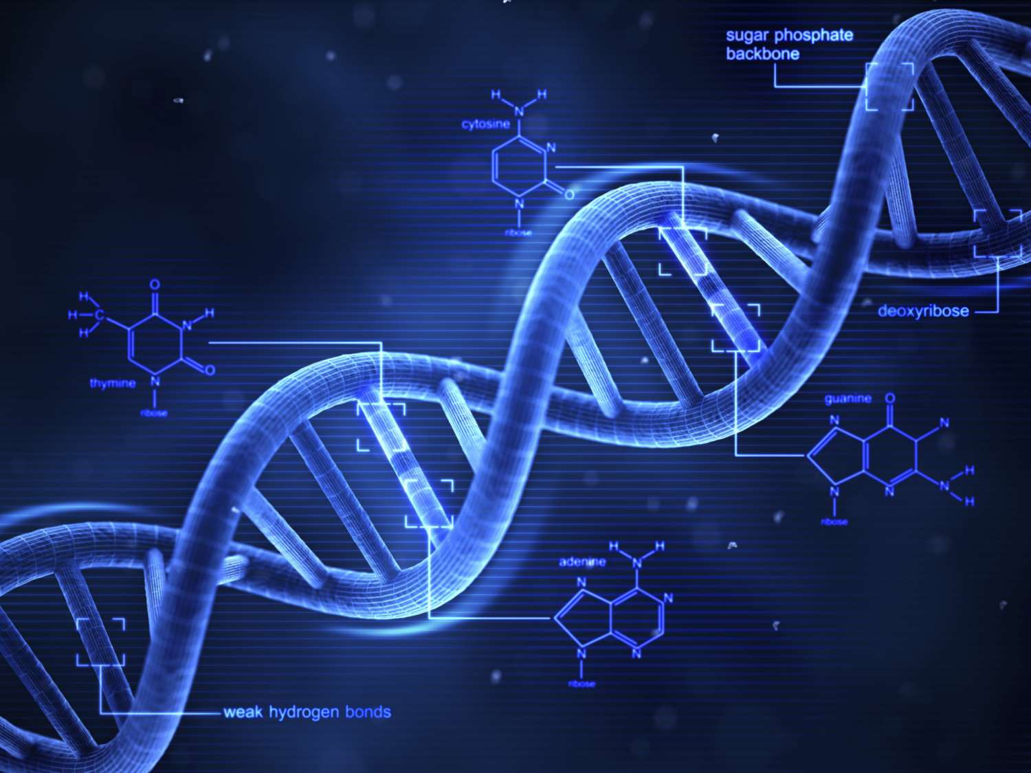
DNA is the most ancient Storage unit

Slide 8
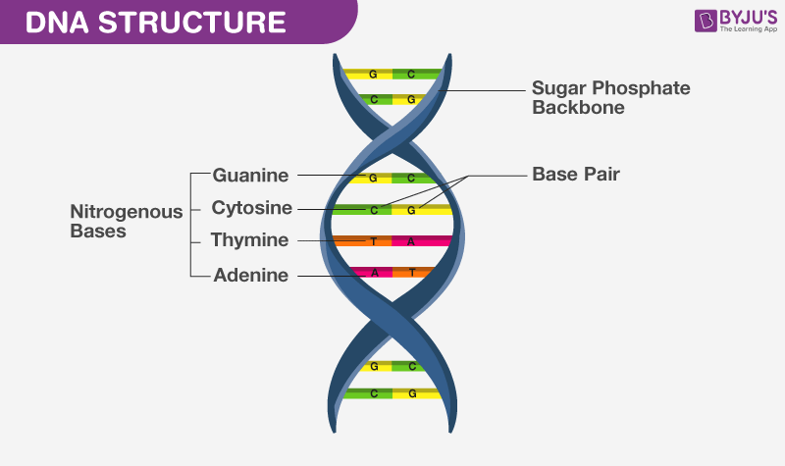
DNA : is consists of 4 types of acids 1- Guanine 2- Cytosine 3- Thymine 4- Adenine

Slide 9

And they are connected to each other in this way

Slide 10
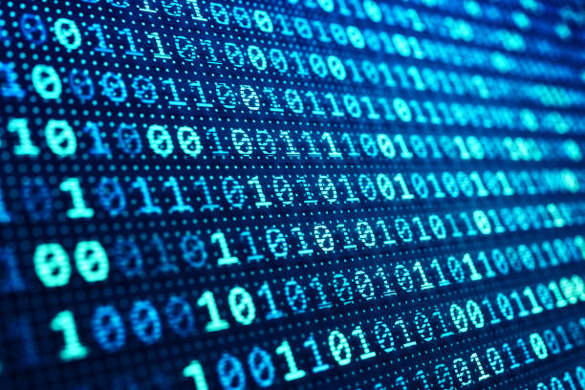
Computer language

Slide 11
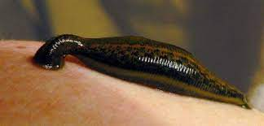
By using nerves from the leech organism we can calculate a mathematical operation such as 2+6=8

Slide 12
Why using bio computer?!

Slide 13


We use biocomputer to calculate (NP) operations

Slide 14
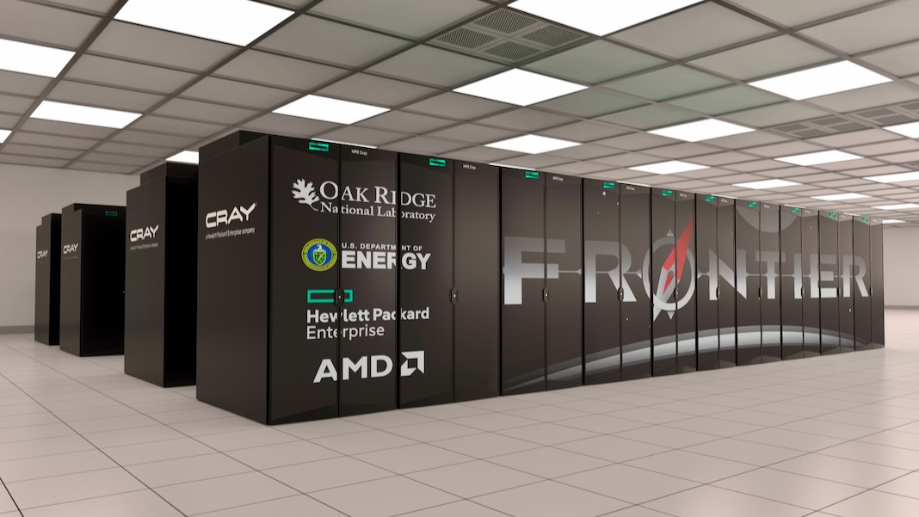
Fronter supercomputer can calculate a quintillion (1,000,000,000,000,000,000) operation per second

Slide 15
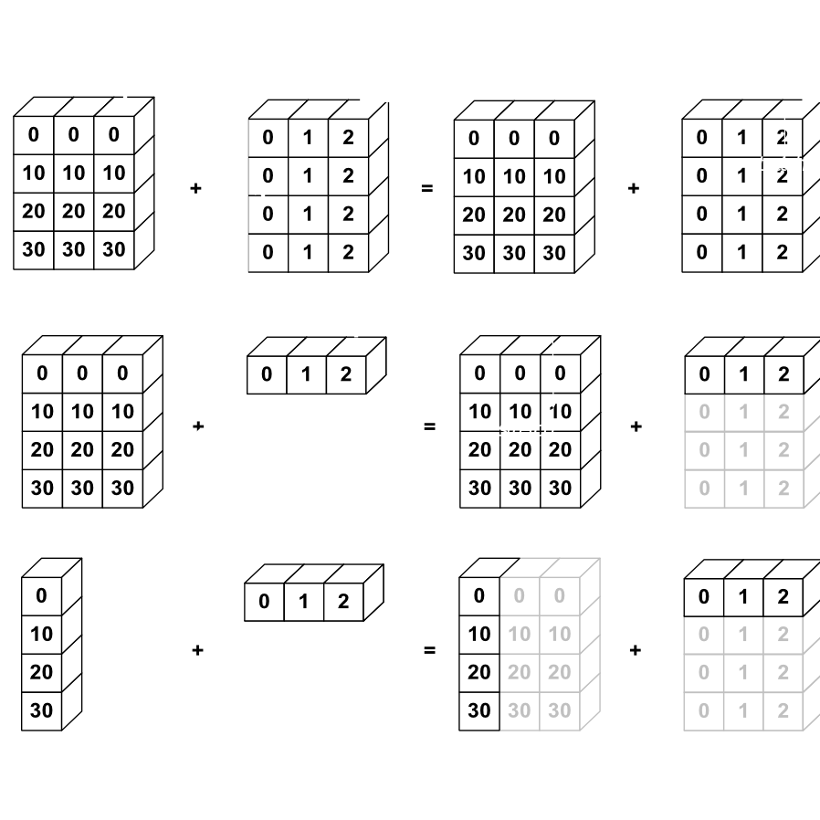
The number of operations that needed to calculate the NP operations (if the numbers =1,000,000) is 2^1,000,000

Slide 16
Fronter needs more than 15 billion year to finish an NP operation

Slide 17
So does we have other options?!

Slide 18

In 2016 they made an operation on myosin protein

Slide 19
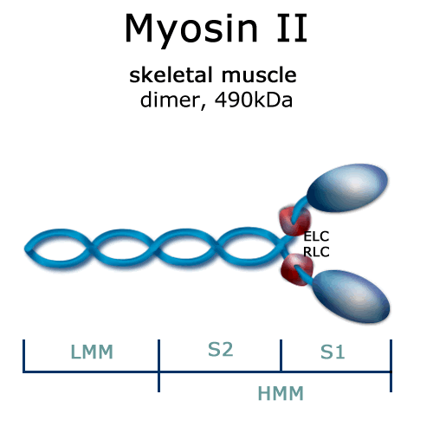
And they discovered that it can finish The NP operations in 30 second

Slide 20
Thank you

